Slide 1
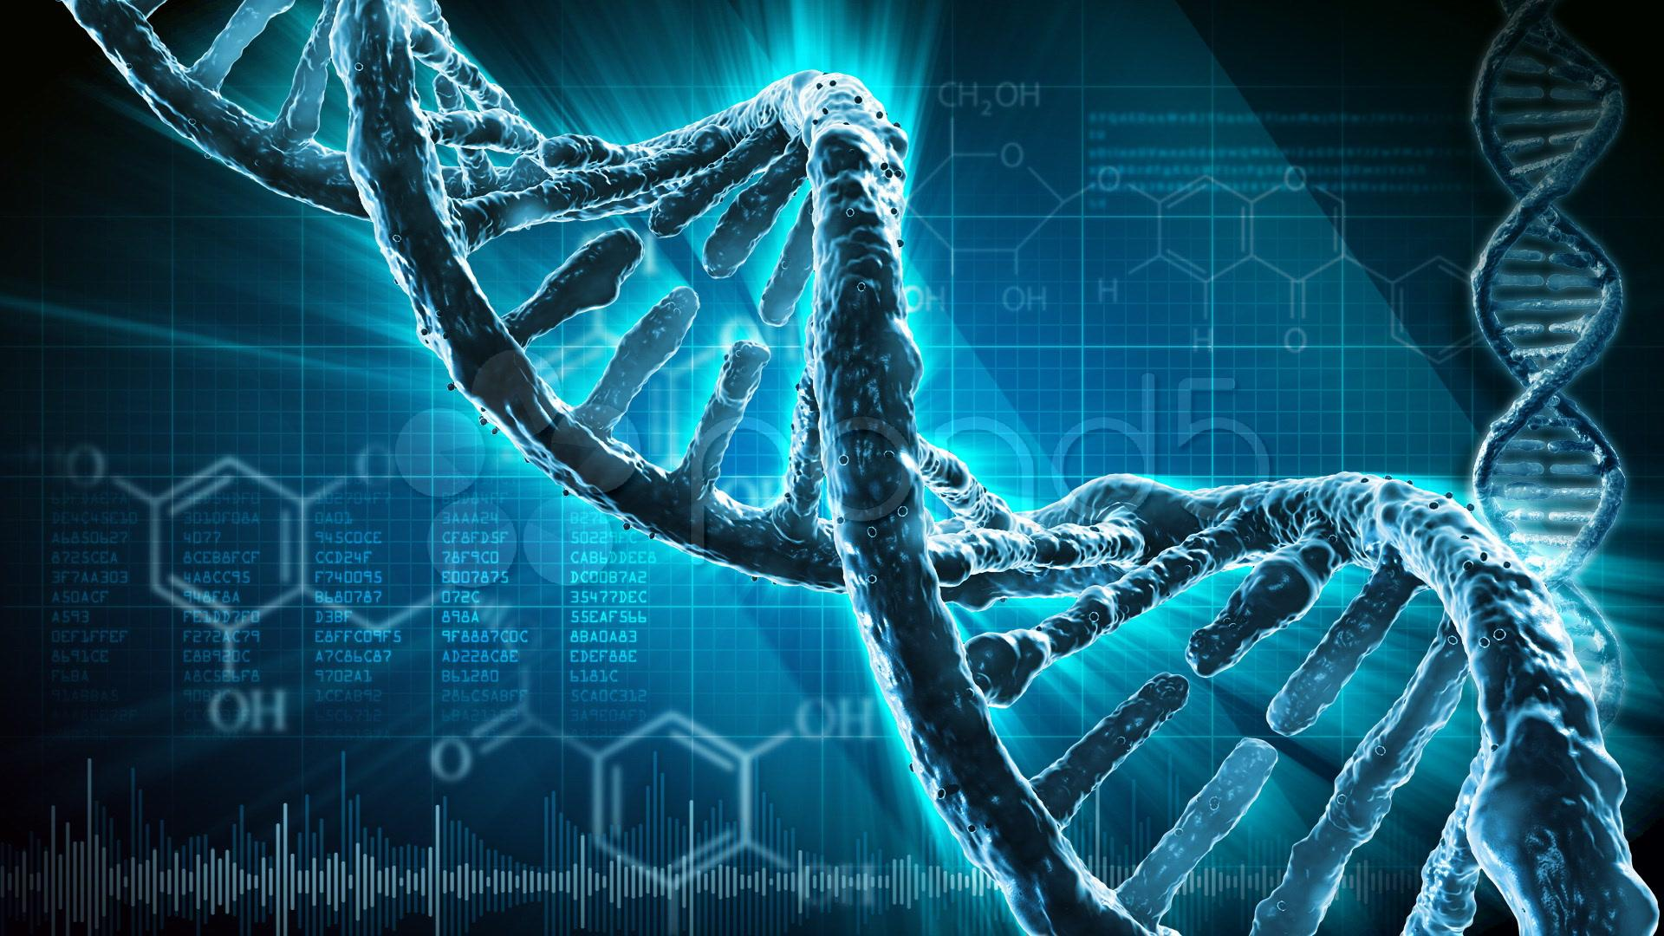
My journey to Python, and biomedical research

Slide 2

@nvaroqua

Slide 3
Engineering degree
  specialized in Software Engineering
Master in Machine Learning
PhD in Computational Biology
Postdoc in the Statistics Department at UC Berkeley and the Berkeley Institute for Data Science

Slide 4
How did I end up here?

Slide 5
Science…

Slide 6
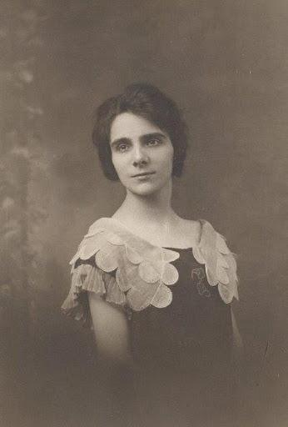
1920

Slide 7
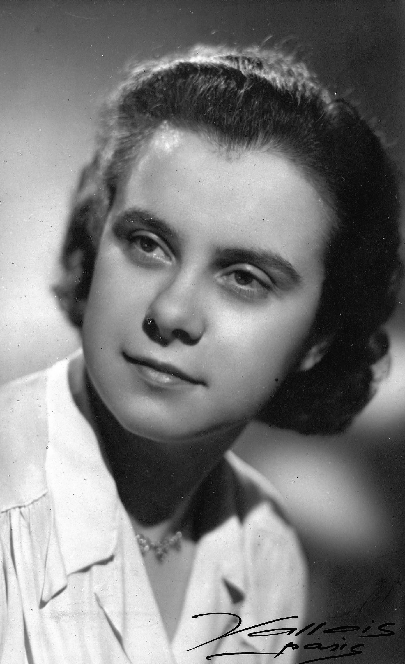
20 years later (1941)

Slide 8

2005

Slide 9
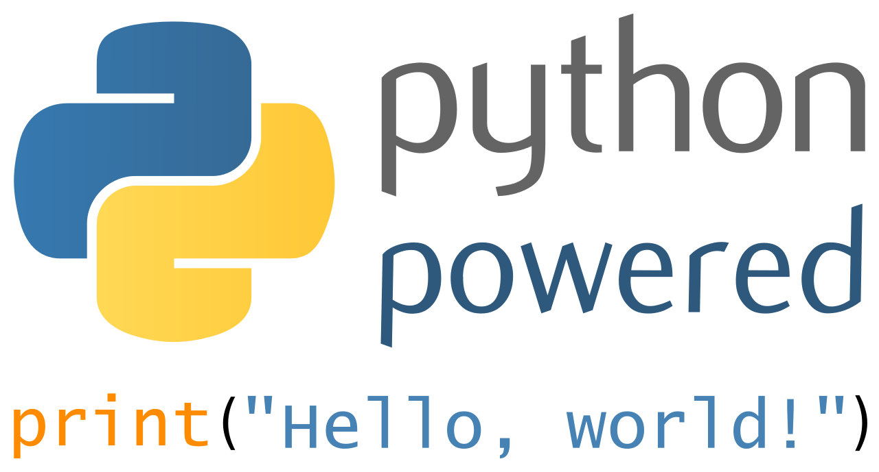
2007

Slide 10
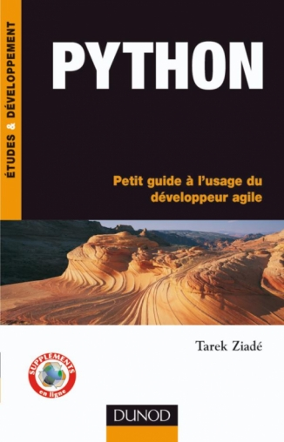
2008

Slide 11

2009
The importance of mentorship

Slide 12
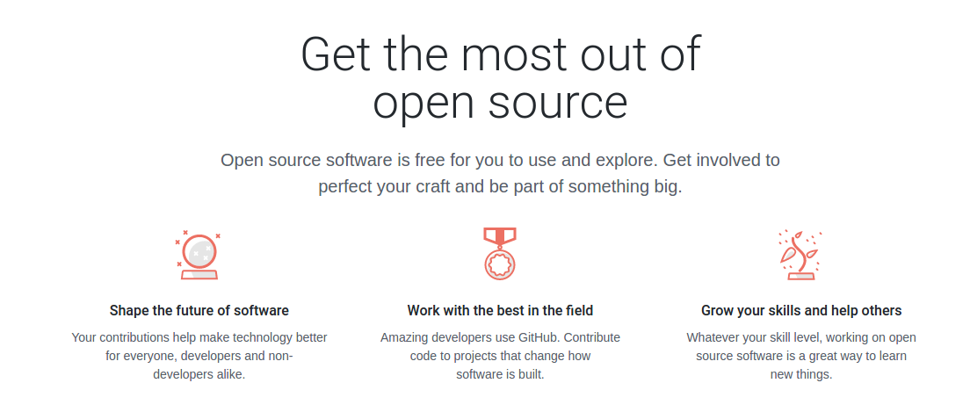
Software programming and open source community

Slide 13

2009
My first contributions to open source

Slide 14
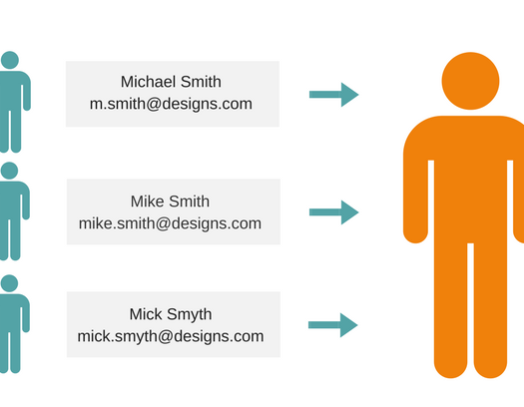
2010
Fuzzy matching

Slide 15

2010
The open source community

Slide 16

2011
Discovering machine learning

Slide 17
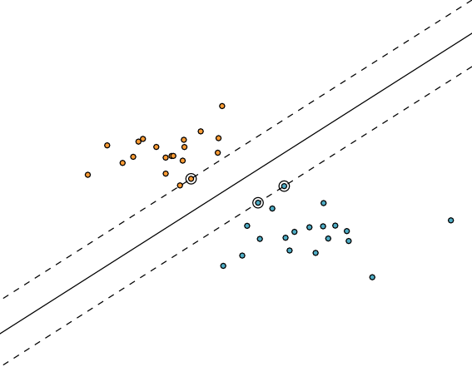
Supervised learning: estimations and predictions

Slide 18
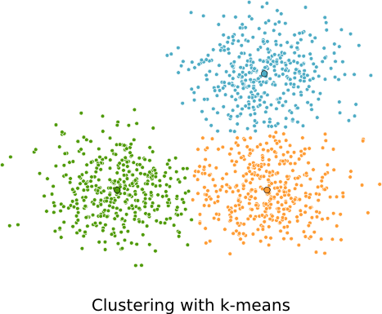
Unsupervised learning

Slide 19
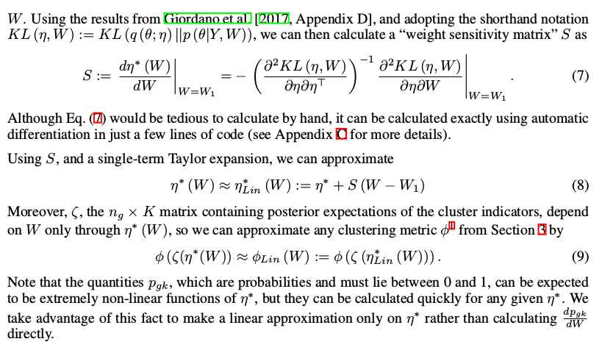
In practice…

Slide 20

2011
Going back to France

Slide 21
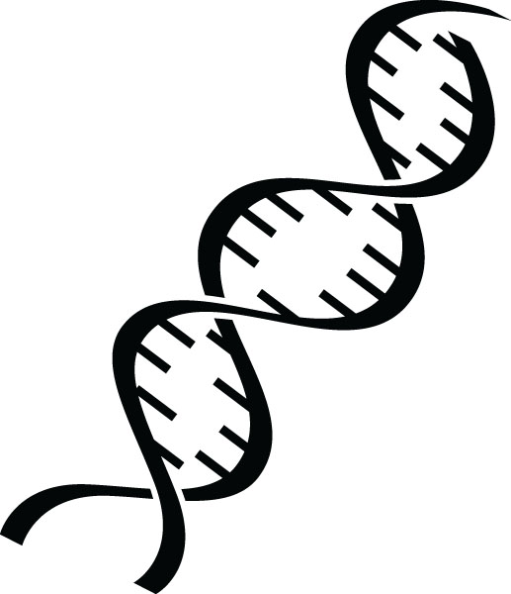
2012
Learning biology the hard way…

Slide 22
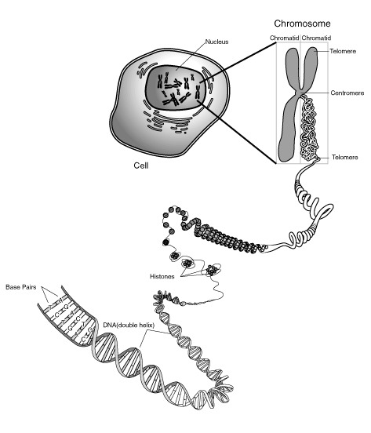
Beings are composed of cells.
Cells contain the genetic code of an individual on the
DNA sequence.
AATCGATAGGCTAGCAATTG
AGACCATATGTTGATAAAAA…

Slide 23
Genome sizes…
Organisme | Chromosome | Genome size
Bacterias | 1 | 400,000 à 10,000,000 | < 1
In search of lost time | 7 | 9,609,000 | 1
Yeast | 12 | 14,000,000 | 1.5
Fly | 4 | 300,000,000 | 30
Human | 46 | 6,000,000,000 | 600
Tulip | 60 | 30,000,000,000 | 3,000

Slide 24
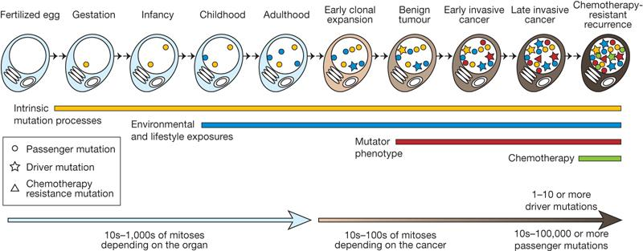
Mutations, evolution and illnesses

Slide 25

What are we interested in?

Slide 26
How can we solve those questions?

Slide 27
Estimations and Predictions

Slide 28




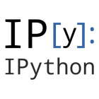

The python ecosystem…

Slide 29
A couple of lines of code
from sklearn import linear_model
clf = linear_model.LinearRegression()
clf.fit ([[0, 0], [1, 1], [2, 2]], [0, 1, 2])
clf.predict([3, 3])

Slide 30
What kind of projects do we tackle?

Slide 31
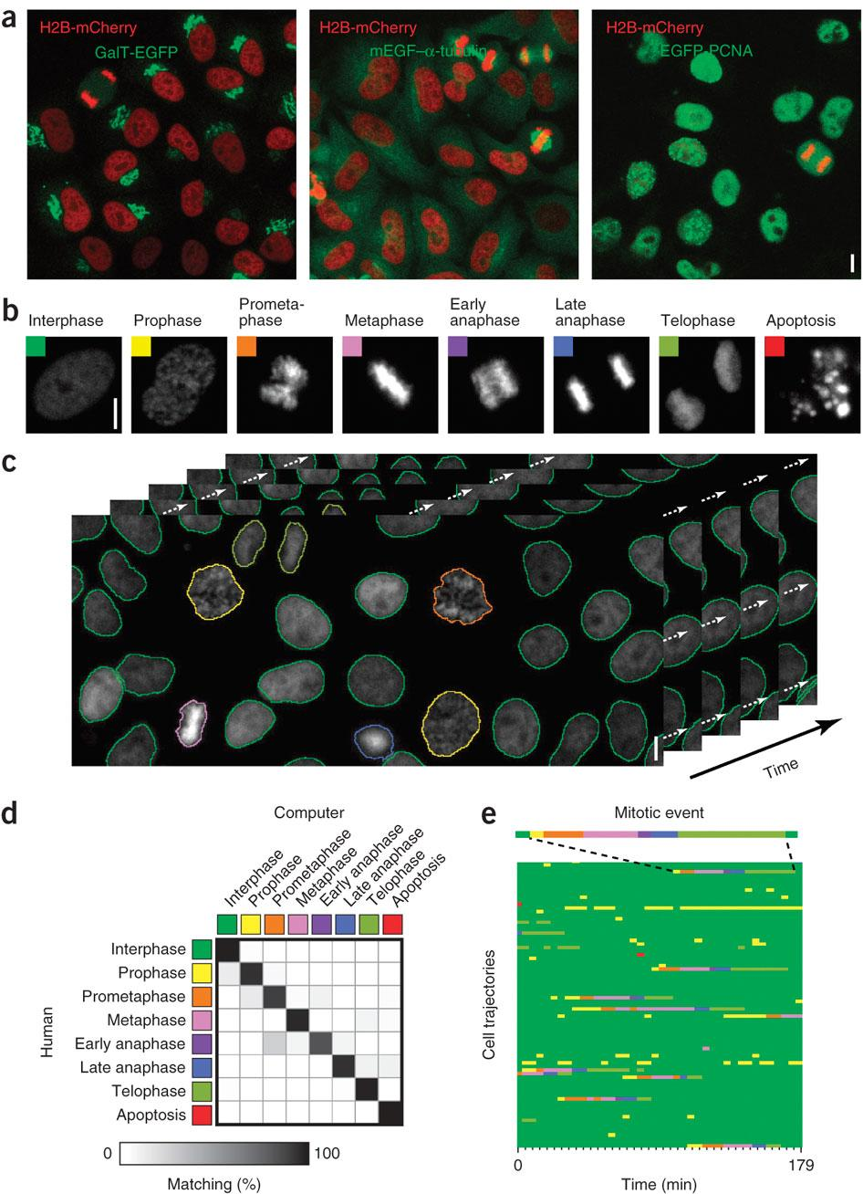
“Cell Cognition”

Slide 32
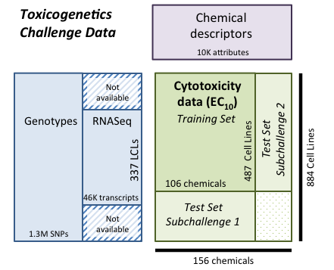
Predicting the toxicity of elements

Slide 33
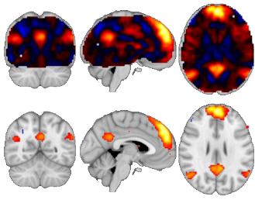
What are you thinking of ?

Slide 34
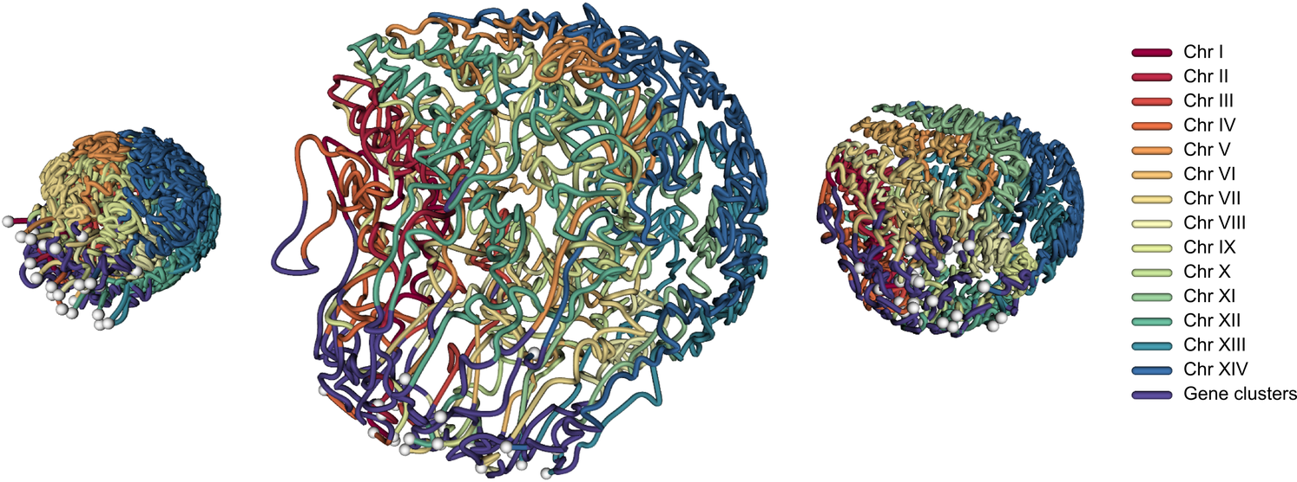
The 3D structure of the genome

Slide 35
Thanks !

